Slide 1
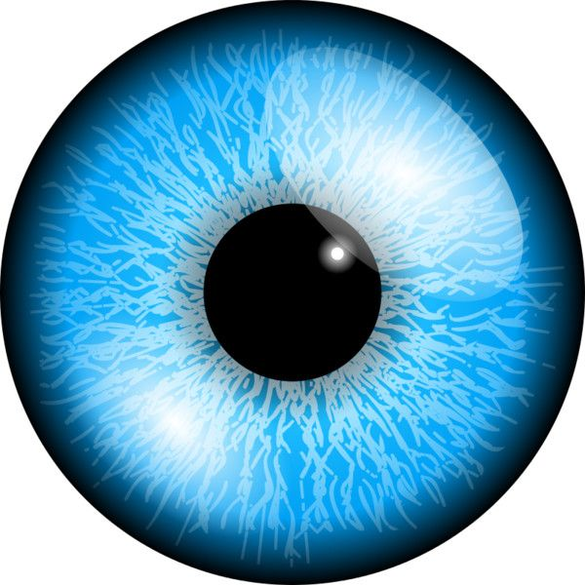
Case presentation

Slide 2
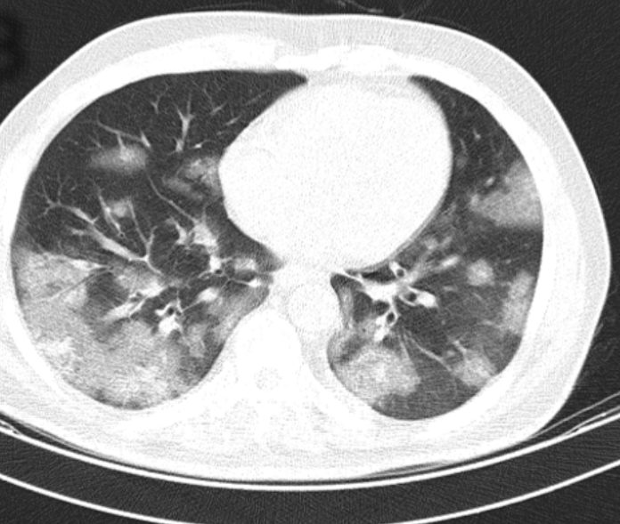
Chief complaint & Present illness
Case 1
A 54-year old male presented with respiratory symptoms of COVID-19 confirmed by PCR and chest CT scan.
On the 15th day of hospitalization he complained of progressive unilateral visual loss+ tearing and mild left sided periorbital pain and ptosis.
Ophthalmology consult was requested.

Slide 3
Past medical Hx: Well controlled DM type 2 (non-insulin dependent)
Drug Hx:
Remdesivir (IV) 200 mg on day 1 followed by 100 mg daily for 4 days
supplementary oxygen (without invasive mechanical ventilation)
Levofloxacin (IV), 500 mg/day
On day 7, Dexamethasone (IV), 8 mg/day was added to mitigate immune-related lung injuries resulted in high blood sugar that was controlled by insulin injections.
Metformin 500 mg, BD, PO was changed to Insulin

Slide 4
Clinical examinations
Genral appearance
Left sided:
-
-Ptosis
-Visible mucoid discharge on eyelashes
Restriction eye movement

Slide 5
Visual acuity:
UCVA OD:10/10
OS :FC1m
Pupils:
OD: round, midsize, reactive
Os: round middliated
EOM:
-OD: NL
-OS: Limittion in all directions (frozen globe)

Slide 6
SLE :
OD:MGD, clear cornea, AC d/cl, ok Iris, Lens: clear
OS: Mucoid discharge, conj injection1+, inf conj chemosis, clear cornea, AC d/cl,
ok iris, Lens:clear
Fundoscopy:
OU: Clear media, pink sharp margin disc,CDR:0.4,No foveal reflex,good vessels,ok periphery

Slide 7
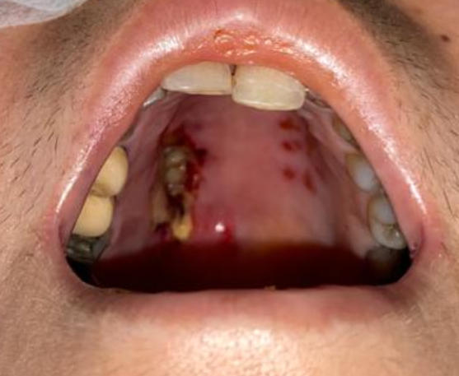
Related systemic evaluations
- decreased corneal sensation/OD
decreased sensation on right cheek
-
- Mental status: Alert and oriented
- No neck stiffness
- Inspection of nasal and oral mucosa: necrotic ulcer on hard palate

Slide 8
Summery of findings
All related to left side
Acute unilateral progressive visual loss
ptosis + Inflammatory signs in periorbital area
Mild conj injection
Complete ophthalmoplegia
Signs of C.N involvement: II, III, IV, V, VI
Hard palate petechial lesions

Slide 9
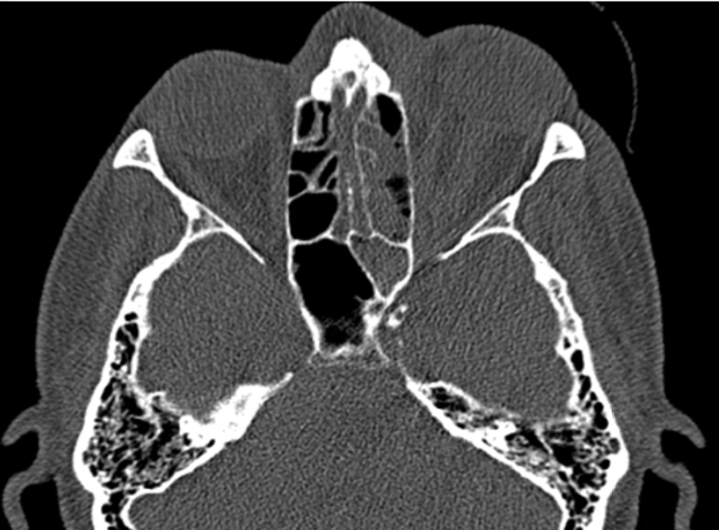
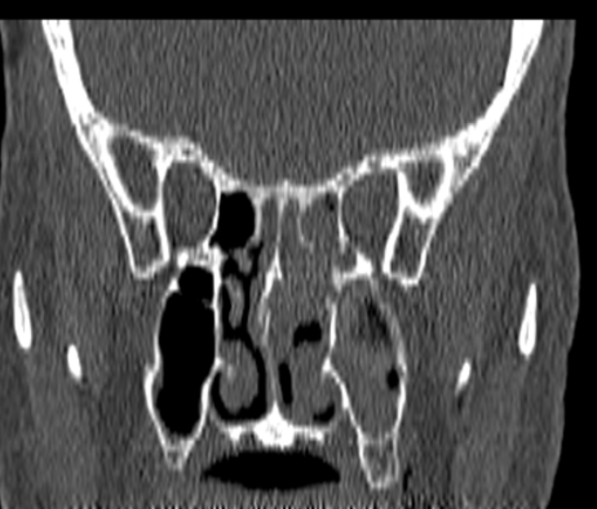
Further diagnostic evaluation
Orbital CT scan

Slide 10
Endoscopic sinus surgery and biopsy
Hyphae and necrotic tissue without much bleeding

Slide 11
Mucormycosis, (phycomycosis , zygomycosis) An aggressive opportunistic fungal infection

Slide 12
The family of Mucoraceae: absidia, rhizopus and mucor.
Mucor is found in soil and on decaying vegetation.
Large numbers of spores are realeased, become airborne and enter the human body through inhalation or ingestion. Humans are exposed on a regular basis.
Rarely causes an infection facing an intact immune system which can phagocytize the spores.
In the immunocompromised, germination and hyphae formation occur and infections can develop:
- rhinoorbitocerebral infection (most common clinical presentation),
- pulmonary,
- gastrointestinal,
- cutaneous,
- renal
- isolated CNS infections

Slide 13
Risk factors
- Diabetes mellitus
- Metabolic acidosis
- Hematological malignancies
- Solid organ transplant
- Use of chronic immunosuppresants
- HIV/AIDS
- Iron overload and treatment with deferoxamine
Presence of major risk factors should raise the index of suspicion considerably, though mucormycosis can also occur in the absence of underlying conditions.

Slide 14
Pathophysiology
soft tissue invasion
Angioinvasion: invades the lumen of blood vessels and adheres to the internal elastic lamina.
Hyphae block the lumen and interrupt perfusion, causing thrombosis, infarction and rapid tissue necrosis accelerated by various fungal proteases, lipases and mycotoxins.
Perineural invasion. spread of infection further away from the primary site of infection, such as through the trigeminal ganglion.
In ROCM, the infection typically starts in the nasal or maxillary sinus and spreads to the sphenoid or ethmoid sinus. From there, it can invade the orbit, either through the ethmoid foramina or nasolacrimal duct or via dehiscence of the lamina papyracea.

Slide 15
Related signs
can affect extraocular muscles, optic nerve and orbital apex structures, causing acute conjunctival chemosis and proptosis, ophthalmoplegia and diplopia.
Due to the angioinvasive properties of the fungus, it can also invade the central retinal artery or ophthalmic artery, possibly leading to a central retinal artery occlusion (CRAO) or ophthalmic artery occlusions (OAO).
Once inside the orbit, the infection can also spread to the brain via the orbital apex or orbital veins, which drain into the cavernous sinus and can cause cavernous sinus thrombosis, carotid cavernous sinus fistula, local multiple occlusive strokes or carotid artery thrombosis.
20% to 40% of patients show signs of a necrotic eschar if the initial infection involves the external nasal or maxillary sinuses.

Slide 16
Outcomes of a Modified Treatment Ladder Algorithm using Retrobulbar Amphotericin B for Invasive Fungal Rhino-Orbital Sinusitis.2021
transcutaneous retrobulbar amphotericin B (TRAMB) for invasive fungal rhino-orbital sinusitis (IFROS) can reduce the risk of exenteration without compromising survival.
. Nearly all patients underwent a surgical intervention, which most commonly was functional endoscopic sinus surgery with debridement. TRAMB was administered to 72.7% of the post-2015 group. Exenteration was more common in the pre-2015 group), while mortality was similar

Slide 17
. After adjusting for potential confounders, patients treated after 2015 were found to have lower risk of exenteration and similar risk of mortality
In comparison to historical controls, patients with IFROS who were treated with a modified treatment ladder algorithm incorporating TRAMB had a lower risk of disfiguring exenteration without an apparent increase in the risk of mortality.

Slide 18
Patient Care
All patients with IFROS were treated according to the generally accepted standard of care. This included administration of systemic antifungal medication, attempted reversal of immunosuppression (e.g. blood sugar control or diminishment/discontinuation of immunosuppressive medications), and sinonasal surgical debridement when appropriate.
After the year of 2015, surgeons in the division of Oculofacial Plastic Surgery began to incorporate transcutaneous retrobulbar amphotericin B (TRAMB) into the routine care of IFROS patients, based on a previously described algorithm.

Slide 19
Radiographic imaging of the orbit, preferably with contrastenhanced magnetic resonance imaging, is used to assess the extent of the infection and the presence of devascularized tissue. Contrast enhancement suggests infection of vital tissue, whereas loss of contrast enhancement has been linked to devascularized tissue that would likely benefit from debridement.
These findings, in combination with the clinical orbital examination, are used to guide orbital management

Slide 20
Injection Protocol
compounded liposomal amphotericin B in a prefilled syringe at a concentration of 3.5 mg/mL. The liposomal formula is favored over the deoxycholate formulation because it causes less tissue inflammation
. Patients were anesthetized with a retrobulbar injection of 2 to 3 mL of lidocaine or bupivacaine to prevent medication-associated pain, since it is inflammatory and must be reconstituted with sterile water. After 5 minutes, a 23-gauge retrobulbar needle was then used to deliver 1 mL of the liposomal amphotericin B to the retrobulbar space in typical fashion. When possible, clinicians directed the injection toward the region of radiographic disease, generally along the medial orbital wall. Gentle pressure was applied to the eyes and patients were observed for 5 minutes after injection to monitor for signs of orbital compartment syndrome;

Slide 21
The patient visual acuity was FC 3m and eye movement to medial gaze improved after 2 injections and after 5 injection more improvement observed
Patient refferd to oculoplastic surgeon for additional treatment

Slide 22
Thanks for your kind attention
Thanks for your kind attention

