Slide 1
Mucormycosis
Dr. Farzad Zamani, M.D.,
Assistant Professor of Otorhinolaryngology-Head and Neck Surgery
Arak University of Medical Sciences

Slide 2
Acute invasive fungal rhinosinusitis (AIFR) is an angioinvasive fungal infection of the nasal cavity and paranasal sinuses that typically develops in immunocompromised patients, such as those with hematologic malignancies, acquired immunodeficiency syndrome, neutropenia, and diabetes.

Slide 3
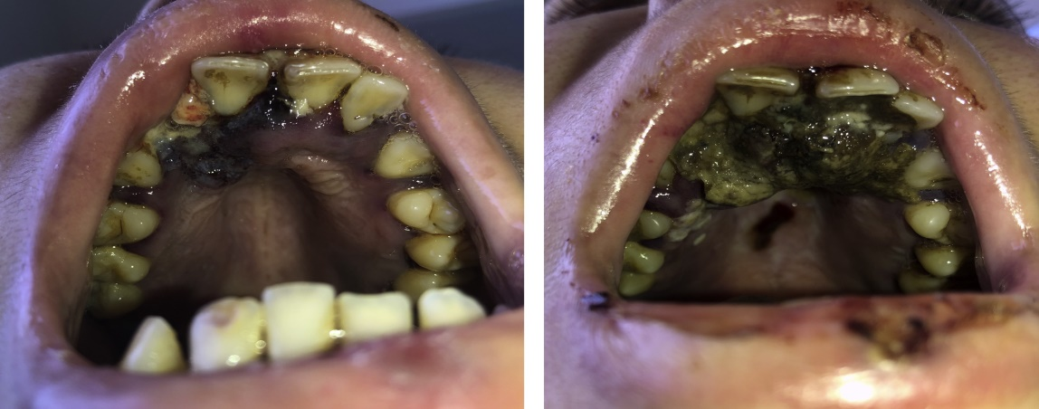
Mortality rates of 40% to 80% in the literature. Patients with AIFR present with fevers and localizing symptoms, most commonly facial swelling, nasal congestion, ophthalmoplegia, proptosis, and vision loss.

Slide 4
The most common organisms: 1. Aspergillus species (most commonly A. fumigatus or A. flavus ) 2. Fungi from the Zygomycetes class, which cause mucormycosis(Rhizopus oryzae)

Slide 5
All patients with suspected AIFR should undergo prompt nasal endoscopic evaluation with particular attention to nasal sensation!

Slide 6
Areas of mucosal pallor, crusting, or necrosis, which are most commonly seen on the middle turbinate should be biopsied and sent for frozen section!

Slide 7
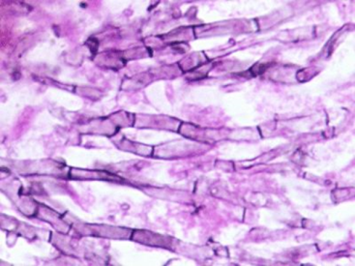
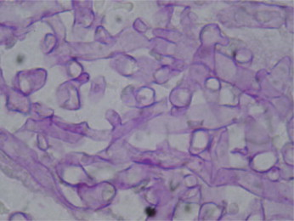
The diagnosis can be made with visualization of necrosis, fungal forms, and angioinvasion on histopathologic analysis.
Aspergillus species demonstrate septate hyphae that branch at acute angles (45 degrees) and Zygomycetes display ribbon-like hyphae that are nonseptate and branch irregularly.
Fungal cultures such as Calcofluor-white and Grocott methenamine silver (GMS), as well as permanent pathology.

Slide 8
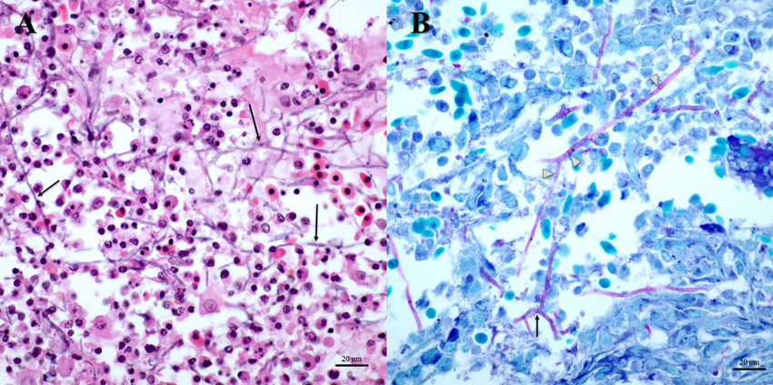
Cultures may also reveal less common causative organisms such as Fusarium and Alternaria species.

Slide 9
Imaging studies should be considered as an adjunct to assess for extent of disease, but should not substitute for a thorough endoscopic examination!
CT scans may reveal nonspecific opacification, with more worrisome findings such as bony erosion typically occurring late in the disease process.
The role of MRI has been evaluated more recently; it may be a more accurate test for assessment of disease extent due to the loss of contrast enhancement seen in devitalized mucosa involved by angioinvasion.

Slide 10
Management of AIFR
Includes antifungal therapy, surgical resection, and reversal of immunocompromise.
Extent of surgery is controversial, particularly with regard to the need for orbital exenteration!
Current evidence:
There may not be an additional survival benefit provided by orbital exenteration!

Slide 11
In patients with neutropenia, some have suggested a role for granulocyte transfusions, although evidence is limited to small case series.
A large systematic review revealed that surgical resection and the use of liposomal amphotericin B were associated with improved survival in patients with AIFR.
Better overall survival was also associated with diabetes.
Poorer overall survival was associated with intracranial involvement and advanced age.

Slide 12
Surgical approach:
Endoscopic sinonasal surgery is the mainstay of treatment.
Initial biopsy is essential
Surgical debridement is commonly included of turbinectomy (middle and inferior), ethmoidectomy, medial maxillectomy, antrostomy, draf I-III, and removal of all devitilized tissue to find bleeding points in the normal vital tissue!

Slide 13
Open approach
Maxiellectomy (partial, subtotal, total, and extended i.e., orbital exenteration) and removal of the palate

