Slide 1
In the name of God
Mucormycosis
Dr.h.mazaherpour
Assistant professor of infectious disease AUMS

Slide 2
A 38-year-old male was admitted to our Hospital, a tertiary care
center with a history of fever for 4 days. He presented with a high grade fever, body ache, cough and shortness of breath. Nasopharyngeal swab was sent for RT-PCR which came positive and a diagnosis of COVID-19 was confirmed.
The patient had no history of diabetes or any other debilitating conditions and no relevant family history.

Slide 3
On admission, the deranged investigations were: Neutrophil
count 83.1% (35–66%), Lymphocyte count 9.5% (24–44%), Fasting
blood sugar (FBS) 98 mg/dL (70-110 mg/dL), Post-prandial blood sugar (PPBS) 146 mg/dL (110-140 mg/dL), HbA1c 6.3% (<6%), Serum
Interleukin-6 37.93 pg/mL (<6.4 pg/mL), CRP 17.84 mg/L (0–6 mg/L),
D-Dimer 460 ng/mL (0–500 ng/mL).

Slide 4
He was monitored in the Intensive Care Unit for 5 days and was
started on Inj.Remdesivir IV with a loading dose of 200 mg, followed by 100 mg daily for 11 days. Methylprednisolone was given by IV infusion, 80 mg/day in 240 mL saline at 10 mL/h for 18 days. Also Inj.Dexamethasone 4 mg twice daily was given for 12 days as a part of COVID-19 management. Post-treatment FBS 125 mg/dL, PPBS 352 mg/dL and HbA1c 12.3%

Slide 5
After 18 days, the patient complaint of swelling and pain in the left
eye. He was referred to the Department of Head and Neck Oncology for the same. On clinically examination, there was malaise, proptosis,
chemosis, periorbital cellulitis and restricted medial gaze. Visual acuity was 6/6 with partial opthalmoplegia and no nasal discharge was seen

Slide 6
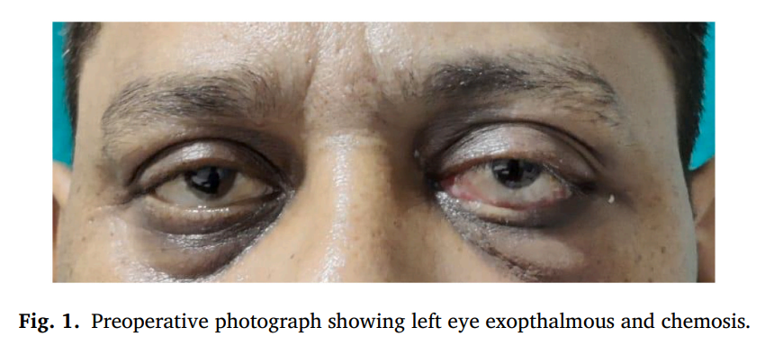

Slide 7
MRI brain & orbit was done showing an ill-defined heterogenous soft
tissue signal intensity (hypointense on T1W-imaging), polyploidal
mucosal thickening involving left maxillary and ethmoid sinuses was
seen. There was displacement of adjacent medial and inferior rectus. Retrobulbar soft tissue fat stranding and edema with resultant displacement of left eye ball anteriorly leading to proptosis was seen. It was also found to be closely abutting the left optic nerve

Slide 8
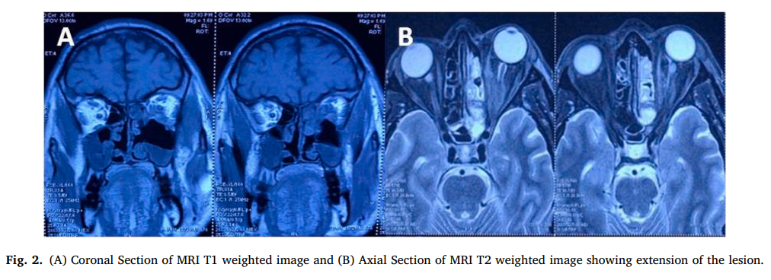

Slide 9
Crusting was noted over posterior aspect of inferior turbinate, septum and conchae. The sinuses were debrided and the specimen obtained was sent for culture sensitivity and histopathology.
On histopathology examination, aseptate broad based hyphae and gram positive bacilli were seen and hence Mucormycosis suspected.
The medical regime changed to Inj. Amphotericin B 300 mg/day, eyedrops Tobramycin BD

Slide 10
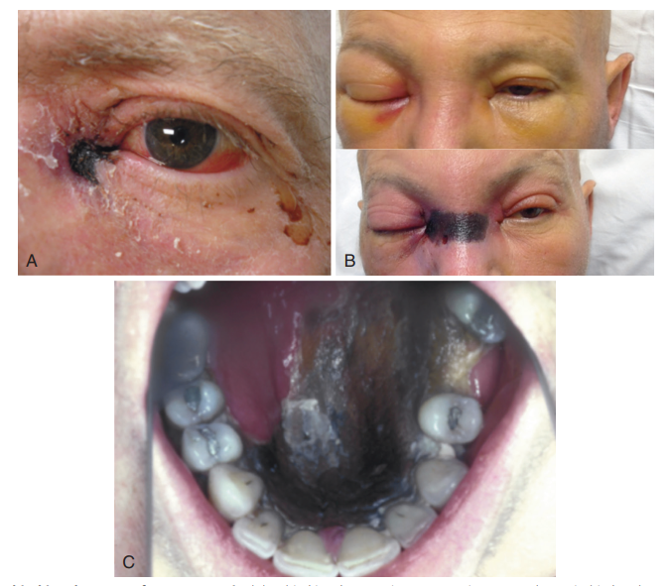

Slide 11
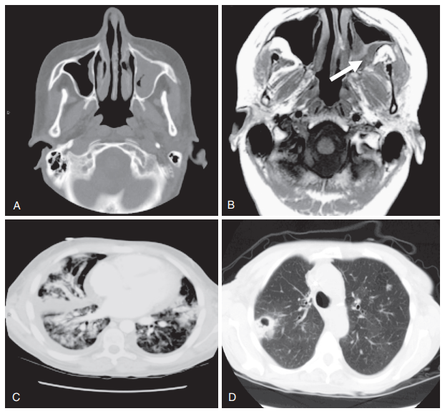

Slide 12
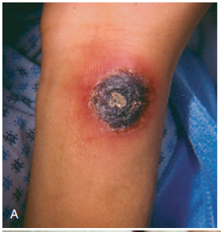

Slide 13
mucormycosis
Agents of mucormycosis are ubiquitous fungi in the environment that
are commonly found in decaying organic substrates, including bread,
fruits, vegetable matter, soil, compost piles, and animal excreta. These
fungi characteristically produce large, ribbon-like hyphae that are
irregular in diameter with only occasional septae, hence the characterization of these organisms as aseptate fungi.

Slide 14
Spores ranging from 3 to 11 µm in diameter are easily aerosolized and dispersed and cause infections in humans when inhaled or introduced through a cutaneous or percutaneous route.
Acquisition of Infection
The primary mode of acquisition of mucormycosis is inhalation of
spores from environmental sources. Trauma, penetrating wounds,
burns, and direct injection of sporangiospores can cause infection through a cutaneous or percutaneous route.

Slide 15
Patient Populations at Risk The populations most commonly at risk for mucormycosis include patients with poorly controlled diabetes mellitus, prolonged neutropenia, high-dose corticosteroid treatment, or immunosuppressive therapy associated with transplantation, and/or elevated levels of free iron, which enhances fungal growth
Patients who develop mucormycosis in the absence of underlying
disease or immunosuppression at the time of infection frequently have histories of penetrating trauma, burns, surgery, or illicit IV drug use before the infection.

Slide 16
Rhinocerebral Infections
Rhinosinusitis, rhino-orbital, and rhinocerebral infections are classic
manifestations of human mucormycosis. Infection is initially localized
to the nasal turbinates and paranasal sinuses after inhalation of spores but can rapidly progress to the orbit (sino-orbital) or brain (rhinocerebral), particularly in patients with diabetic ketoacidosis or profound neutropenia.

Slide 17
Clinical Presentation Initial symptoms of sinus invasion by mucormycosis are indistinguishable from other more common causes of sinusitis. Sinus pain, congestion, headache, mouth or facial pain, otologic symptoms, and hyposmia or anosmia are common
Involved tissues become red, then violaceous, and finally black with thrombosis and tissue necrosis. Necrotic eschars of the nasal cavity and turbinates, facial lesions around the nose, and exophytic or necrotic lesions of the hard palate extending from the maxillary sinus are signs of rapidly progressing infection.

Slide 18
Extension of sinus disease is primarily into contiguous structures.
Maxillary sinus infection extends into the hard palate, nasal cavity, and ethmoid sinus. Sphenoid disease invades the cavernous sinus, contiguous temporal lobe, and internal carotid artery in the siphon. Septic emboli from the carotid artery into the frontal and parietal lobes can occur.
Ethmoid sinus disease may invade the face or frontal lobe but easily
crosses the lamina papyracea into the orbit.

Slide 19
Periorbital edema, ptosis, proptosis, chemosis, and preseptal and orbital edema are early signs of orbital extension. Pain and blurring or loss of vision often indicate invasion of the globe or optic nerve.
Patients with extensive rhino-orbital or rhinocerebral disease may present with trigeminal and ocular motor nerve palsy after cavernous sinus invasion
A bloody nasal discharge may be an early sign of nasal mucosal invasion.

Slide 20
Radiology
Radiographic imaging is often suggestive of severe sinusitis but lacks
the specificity to diagnose rhinocerebral mucormycosis. Computed tomography (CT) of the sinuses typically reveals mucosal thickening, air-fluid levels, and bony erosion
Extraorbital muscle thickening is often the first sign on CT or MRI of
orbital involvement and should prompt empirical antifungal therapy
until surgical exploration or biopsy of the sinus and orbits can be performed, which should be done as soon as possible.

Slide 21
TREATMENT
Successful treatment of mucormycosis relies on timely diagnosis, reversal of underlying predisposing factors, early surgical débridement of infected tissue, and rapid initiation of effective high-dose systemic antifungal therapy.
Early diagnosis is critical to the outcome of mucormycosis
because small focal lesions can be surgically resected before the lesions progress to involve critical structures or distal organs

Slide 22
Patients with suspected rhinocerebral mucormycosis should undergo
a thorough examination and “staging” of their disease, including CT
of the paranasal sinuses and lungs as well as endoscopic examination
of nasal turbinates with biopsy of any suspicious lesions or necrotic
eschars.

Slide 23
Rapid correction of predisposing conditions, such as control of hyperglycemia, reversal of ketoacidosis, and rapid tapering of glucocorticoid therapy, are critical for reversing conditions that favor fungal virulence and dissemination.

Slide 24
Antifungal Therapy
Historically, the drug of choice for the treatment of mucormycosis
was conventional amphotericin B deoxycholate (ABD), administered at the maximal tolerated doses of 1 to 1.5 mg/kg/day.
Unfortunately, high doses of conventional amphotericin B are usually not tolerated for more than several days before renal function deteriorates, especially in patients with diabetes or receiving concomitant nephrotoxic therapies.

Slide 25
Lipid Amphotericin B Formulations Lipid formulations of amphotericin B are safer than ABD for long-term administration and, in our opinion, are the preferred first-line treatment for severe mucormycosis.
In one of the few published case series, 24 patients with mucormycosis and diabetes as the predominant underlying risk factors were treated with ABLC after failure or intolerance of the conventional ABD formulation

Slide 26
The overall response rate (improvement or cure of infection)
was 71% , with few reported toxic effects, even in patients with preexisting renal dysfunction.
Several case series have reported the successful treatment of mucormycosis with the liposomal formulation of amphotericin B, sometimes administered at high doses (i.e., 10 mg/kg/day) for prolonged treatment courses

Slide 27
The optimal dosing approach for L-AMB in patients with mucormycosis is frequently debated. Preclinical pharmacokinetics/ pharmacodynamics studies in murine models of pulmonary mucormycosis that simulated human dosing have suggested that ABLC at 5 mg/kg/day or L-AMB at 10 mg/kg/day results in rapid antifungal accumulation in the lung, reduced fungal burden, and improved survival.

Slide 28
In one of the few randomized trials that compared standard doses
of L-AMB (3 mg/kg/day) to a higher dose-regimen (10 mg/kg/day for
14 days, then 3 mg/kg/day) for invasive aspergillosis, patients randomized to the higher-dosed L-AMB regimen failed to achieve higher response rates but experienced significantly higher rates of nephrotoxicity and severe hypokalemia

Slide 29
The feasibility of high-dose (10 mg/kg/day) L-AMB treatment for
the initial treatment of mucormycosis was explored in a multicentric
prospective French study of 40 patients with invasive mucormycosis. The planned treatment of 10 mg/kg/day was administered as an infusion of at least 2 hours for 4 weeks.

Slide 30
Of importance, although 4 weeks of high-dose L-AMB was planned,
the average treatment duration at this dose was 13.5 days (range, 0–28), with 40% of patients experiencing a doubling in the baseline serum creatinine and severe hypokalemia (serum potassium <3 mmol/L).
Therefore considerations for using doses of L-AMB higher than 5 mg/
kg/day should take into account that a sizable proportion of patients
will develop renal injury requiring dosage reduction or possibly a switch to triazole therapy after the first 1 to 2 weeks of therapy.

Slide 31
Triazoles
The prospects for using posaconazole in the treatment of mucormycosis has improved with the introduction of an extended-release tablet formulation with improved bioavailability compared with the older suspension, and an IV formulation solubilized in sulfobutyl ether β-cyclodextrin.
In an open-label study evaluating posaconazole as salvage therapy (not initial therapy), the overall success rate of posaconazole (800 mg/day) was 70% in 24 patients, and it was well tolerated with only minimal GI side effects.

Slide 32
At present the US Food and Drug Administration (FDA) has not approved posaconazole for primary or salvage therapy of mucormycosis, indicating the need for further studies.
The extended-release tablet formulation of posaconazole is administered at a dose of 300 mg (three 100-mg delayed-release tablets) twice a day on the first day, then 300 mg daily.

Slide 33
Although the absorption of the tablets is improved with food, the tablets have adequate bioavailability even in patients with poor dietary intake or receiving acid-suppression therapy, such as a proton pump inhibitor.
The IV formulation of posaconazole is dosed at 300 mg IV twice daily on day 1, followed by 300 mg daily thereafter,

Slide 34
Although therapeutic drug monitoring has been recommended for
posaconazole in Aspergillus treatment guidelines to ensure serum trough levels greater than 1.5 mg/L during the treatment of infection, a similar relationship between serum trough levels of posaconazole and outcome of mucormycosis has not been reported.
In 2015 the FDA approved isavuconazole for treatment of invasive
mucormycosis

Slide 35
Isavuconazole may be a possible alternative to posaconazole or L-AMB, particularly for longer-term therapy.
An advantage of isavuconazole is that it is administered as a
prodrug formulation (isavuconazonium) in either an IV and oral formulation with excellent bioavailability that is not affected by dietary intake or acid-suppression therapy.

Slide 36
Isavuconazole is dosed with a 372-mg loading dose administered every 8 hours for 6 doses (48 hours), then a 372-mg maintenance dose daily.
Isavuconazole is generally well tolerated, making it a possible alternative for patients who are clinically stable and have limiting drug interactions with posaconazole or cannot tolerate the nephrotoxic effects of L-AMB.

Slide 37
Isavuconazole is available in oral and IV formulations and presents some advantages: linear pharmacokinetics, few interactions with cytochrome P450 isoenzymes leading to few drug– drug interactions, QT decrease, no nephrotoxic cyclodextrin in the IV formulation (different from posaconazole IV form), no need for dose adjustment in kidney or liver failure and in obesity, and excellent oral bioavailability with no food requirements

Slide 38
Concentration of ISZ in the necrotic center of brain abscess has been shown low, but concentration in inflammatory brain tissue surrounding the abscess was adequate, equivalent to predicted plasma concentration
Routine therapeutic drug monitoring (TDM) is strongly recommended for patients treated by PSZ . Serum trough PSZ concentrations of 1.5 mg/L or higher are recommended. However, there is currently no conclusive evidence for routine TDM with ISZ.

Slide 39
New antifungal drugs
Some new antifungal drugs are under clinical evaluation include Rezafungin, SCY-078, orolofim, and encochleated amphotericin B . Rezafungin, a new echinocandin has not been tested against Mucorales. SCY-078, member of a new glucan synthase inhibitor subclass is poorly or not active against Mucorales. Olorofim is a member of the orotomides, a new antifungal class inhibiting dihydroorotate dehydrogenase (DHODH), a key enzyme in pyrimidine biosynthesis. It is also poorly active against Mucorales.

Slide 40
Encochleated amphotericin B is a new oral formulation of amphotericin B. It has been shown to be well-tolerated, and is currently tested for cryptococcosis treatment in developing countries (clinical trial 161 NCT04031833). No studies on Mucorales efficacy are available.

Slide 41
Combination Therapy
Successful treatment of mucormycosis with combinations of amphotericin B, terbinafine, rifampicin, L-AMB, posaconazole, and echinocandins has also been described in small case series and case reports.
One of the largest case-control studies evaluating the possible benefits of combination therapy for invasive mucormycosis
was performed at MD Anderson Cancer Center, which identified 47 patients who received early L-AMB monotherapy and 59 patients who received combination treatment. There was no difference in mortality between 2 groups of combination and monotherapy.

Slide 42
The most common combination regimens were L-AMB plus an echinocandin (46%), L-AMB plus posaconazole (27%), or triple combination therapy (27%).
The investigators could not identify any survival benefit for
combination therapy over timely administration of L-AMB, even after
propensity score adjustment

Slide 43
Treatment Duration
The duration of treatment required for mucormycosis is highly individualized to the patient. Near normalization of radiographic imaging, negative biopsy specimens, and cultures from the affected site and recovery from immunosuppression are indicators that a patient is a candidate for stopping antifungal therapy
Late relapses of mucormycosis after successful treatment have been reported several years after discontinuation of secondary posaconazole prophylaxis or onset of new immunosuppression

Slide 44
Therefore continued follow-up of patients is critical in any patient who discontinues treatment for mucormycosis.
Prophylaxis Because mucormycosis is a relatively rare infection, primary prophylaxis is generally not recommended. Secondary prophylaxis is often desired in patients requiring further immunosuppression after treatment for mucormycosis.

Slide 45
Posaconazole, and possibly isavuconazole, appears to be a safe option for patients who require continuous, oral long-term antifungal therapy because they remain at high risk for relapsing infection
Adjunctive Therapies Patients with profound neutropenia and progressive mucormycosis despite optimal therapy may be candidates for neutrophil transfusion. With currently available techniques, more than 10¹⁰ granulocytes can be infused, resulting in an immediate postinfusion absolute neutrophil count usually exceeding 1000/µL.

Slide 46
Hyperbaric oxygen therapy was reported to be a beneficial adjunct to standard surgical and antifungal therapy for mucormycosis, particularly for diabetic patients with rhinocerebral disease.
Although this is not one of the approved uses of hyperbaric oxygen, the increased oxygen pressure achieved with hyperbaric oxygen may improve neutrophil activity and the putative oxidative killing
effects of polyene antifungals.

Slide 47
Multiple immune-augmentation strategies have been proposed for
mucormycosis, including administration of cytokines that enhance
phagocytic activity, such as granulocyte colony-stimulating factor,
granulocyte-macrophage colony-stimulating factor, or IFN-γ alone or
in combination with granulocyte transfusions.

Slide 48
Prognosis The site of infection and underlying host factors are the key prognostic determinants of mucormycosis outcome. Active hematologic malignancy, allogeneic HSCT, and disseminated infection are associated with poor outcome.
However, earlier diagnosis of the disease and aggressive treatment have been associated with improved survival rates in recent series.

Slide 49
Correction of underlying immune impairment (e.g., rapid tapering of
glucocorticoids), combined with aggressive multimodality treatment
approaches, offer the best chance for patient survival.

Slide 50
Thanks for your attention

