Slide 3
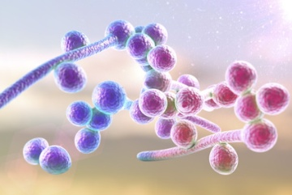
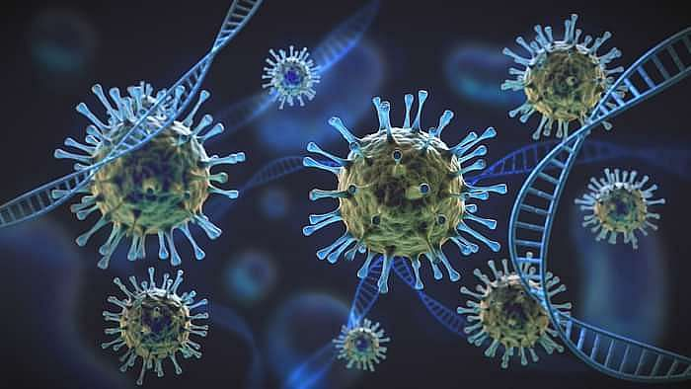
Diagnosis of mucoromycosis in patients with COVID-19 Present by :
Dr. Mojtaba Didehdar

Slide 5
Mucormycosis
Mucormycosis (sometimes called Systemic zygomycosis) is a serious but rare fungal infection caused by a group of molds called mucorals invasive fungal infections (IFI)
Caused by saprophytic environmental fungi, belonging to the subphylum Mucoromycotina, order Mucorales. Among the most frequent genera are Rhizopus and Mucor; and less frequently Lichtheimia, Saksenaea, Rhizomucor, Apophysomyces, and Cunninghamela
Rhizopus arrhizus

Slide 6
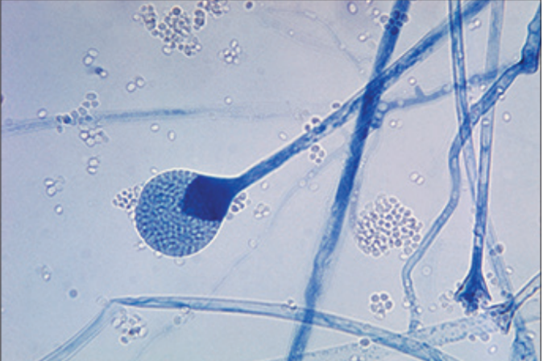

Slide 7
Mucormycosis
It is characterized by vascular invasion by the fungal hyphae which leads to thrombosis and necrosis.
There has been a surge of mucormycosis co-infection in COVID-19 patients, many cases being reported worldwide.
The incidence of mucormycosis has risen more rapidly during the second wave compared with the first wave of COVID-19 in India, with at least 14872 cases as of May 28, 2021.

Slide 8
Mucormycosis
CAM ( Covid associated Mucormycosis) outbreak reasons (Host General Conditions)
Enviromental Factors
Diabetes and BS
Sreroid therapy
Hyper Ferritinemia & Fe
Endothelial cell receptor ( GRP78 ??? )

Slide 9
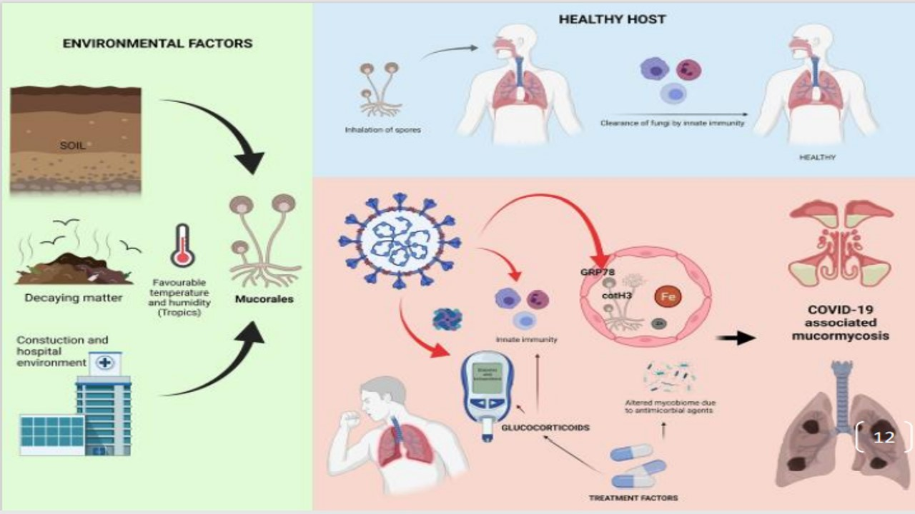

Slide 12
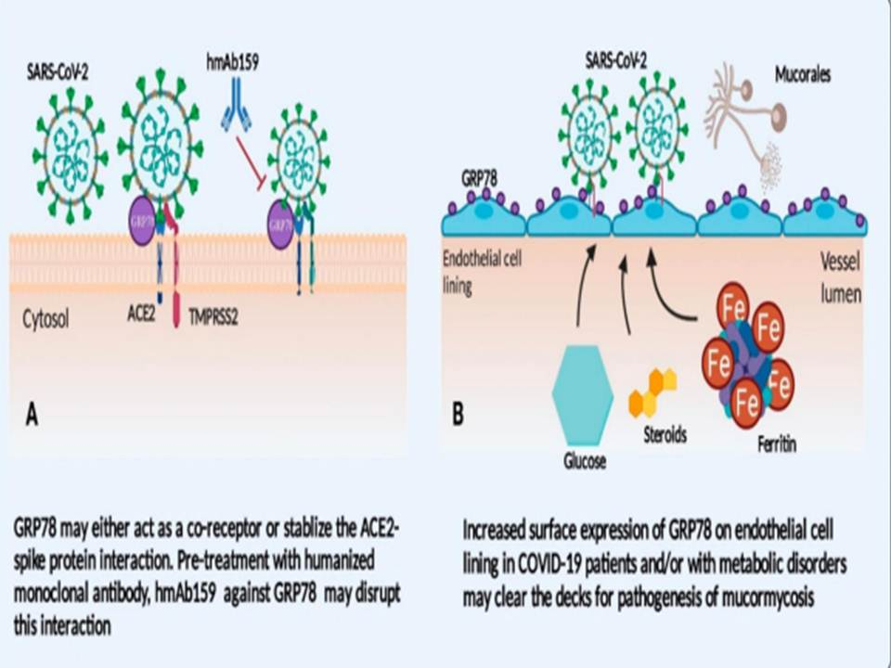

Slide 16
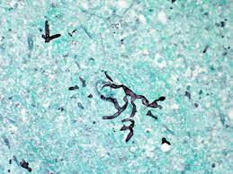
Culture
The high number of culture-negative find­ings and, yet, microscopically positive findings may reflect the friability of hyphae and the fragile nonseptated growth of these fungi, thus becoming mechanically damageable during tissue excessive grinding (excessive tissue homogenization should be avoided)

Slide 17
Culture
The species-level identification of the causative agent from cultures on the basis of its morphological char­acteristics is challenging.
Furthermore, requires expertise and proper sampling and the collected strains from patients who receive antifungals, which sometimes show morphological abnormalities making it difficult to perform a cor­rect identification.

Slide 18
Molecular methods
The use of molecular-based assays can help to detect different Mucor species and it can be recommended as a valuable add on tool that complements conventional diagnostic procedures.

Slide 19
Molecular methods
Semi-nested qPCR
HRM
Internal transcribed spacer (ITS) sequencing
However, the efficiency of molecular-based diagnosis requires a thorough clinical evaluation and has not been widely confirmed; therefore, it cannot be recommended as a standalone, single approach to clinical routine diagnostics.

Slide 20
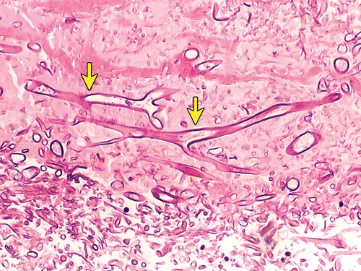
Histopathological findings
Histopathological findings can be very helpful in diagnosis.
Obtaining a diagnosis of mucormycosis on histomorphological basis is challenging, and the most common cause for incorrect morphological diagnosis is the misidentification of Mucorales as Aspergillus spp.

Slide 21
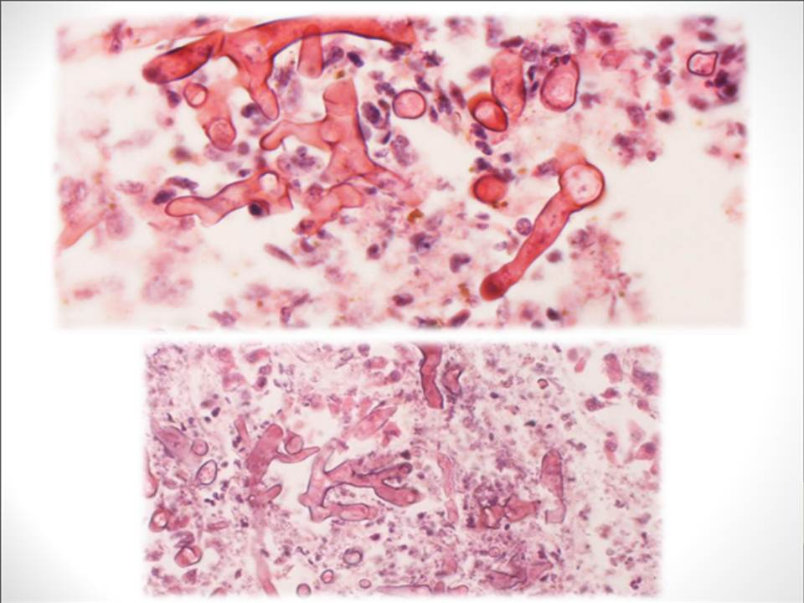

Slide 22
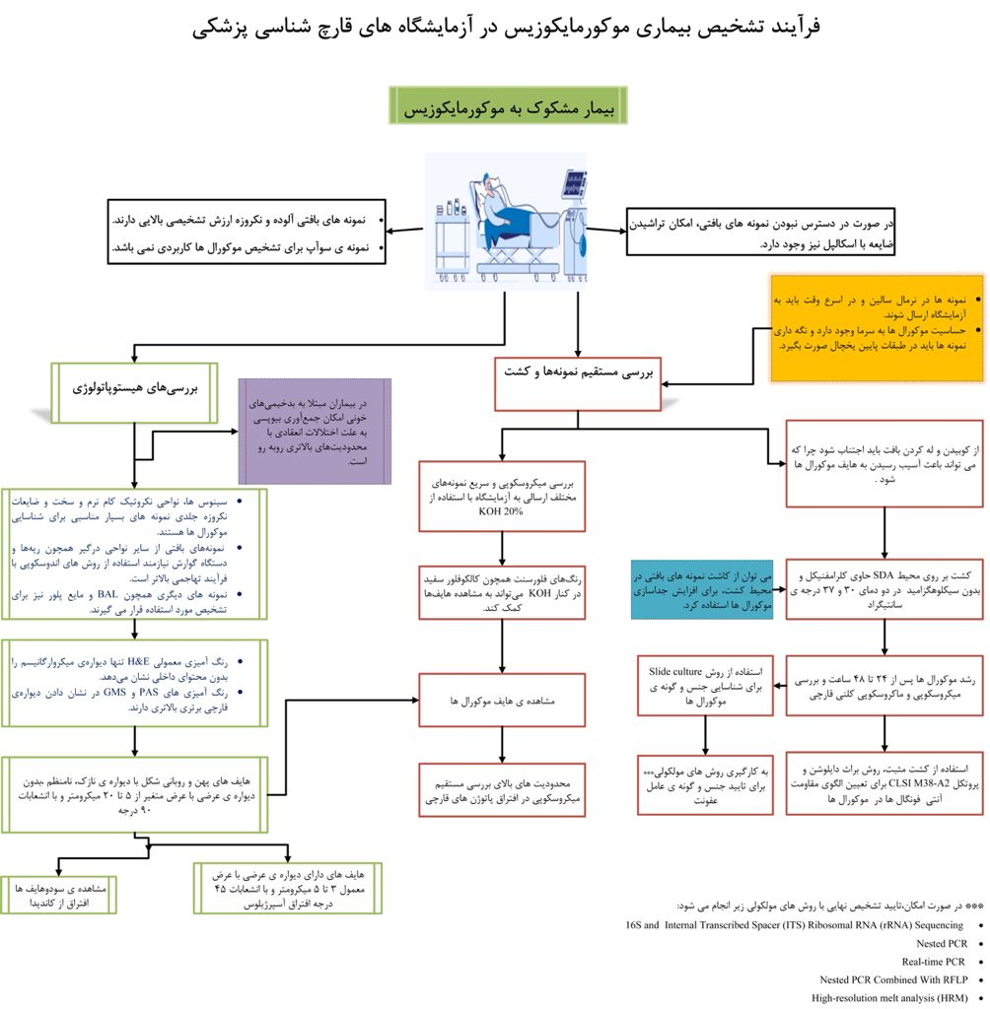

Slide 23
